Slide 1
School of Geography and Geology
McMaster University
Introduction to Spatial Statistics
(510-654)
PART IV:
Spatially Continuous Data
(Cont’d)

Slide 2
This session:
Part IV: Spatially Continuous Data
  Definitions
  Visualization
  Exploration
    First Order Properties
    Moving Averages
    Kernel Estimation
    Tesselation Methods
  Second Order Properties
    Covariogram, correlogram and Variogram

Slide 3
Spatially continuous data:
Visualization of first order effects
Visualization
  Symbol maps
  Indicator maps
  Grayscale maps
  Proportional symbol maps
  Colors
  …

Slide 4

Visualization of first order effects: Symbol map
0
5

Slide 5



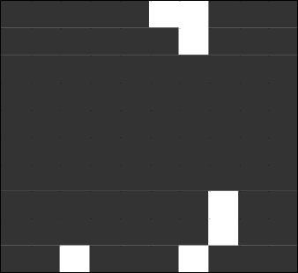
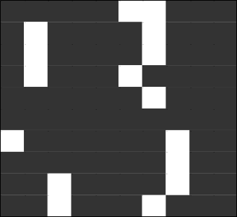
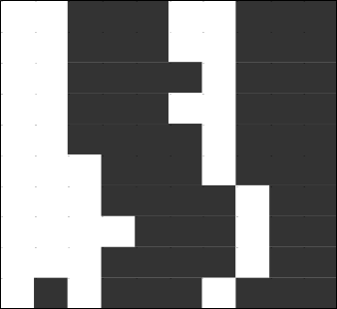

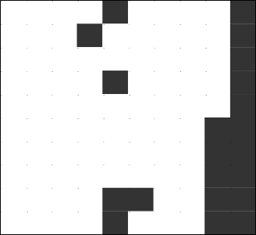
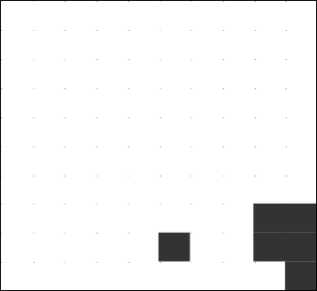
Visualization of first order effects:
Indicator maps
V<15 ppm V≥15 ppm
V<30 ppm V≥30 ppm
V<45 ppm V≥45 ppm
V<60 ppm V≥60 ppm
V<75 ppm V≥75 ppm
V<90 ppm V≥90 ppm
V<105 ppm V≥105 ppm
V<120 ppm V≥120 ppm
V<135 ppm V≥135 ppm

Slide 6
Visualization of first order effects:
Grayscale map

Slide 7
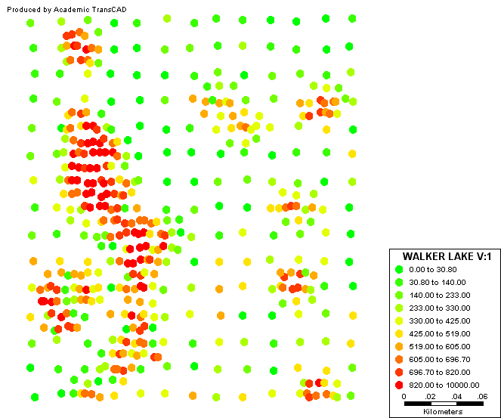
Visualization of first order effects:
Symbol map w/colors

Slide 8
Spatially continuous data:
Exploration of first order effects
Exploration
  Moving averages
  Kernel estimation
  Tesselations
    Gradient maps
    Contour maps

Slide 9
Exploration of first order effects:
Moving Averages

Slide 10
Exploration of first order effects:
Kernel Estimation
Kernel function

Slide 11
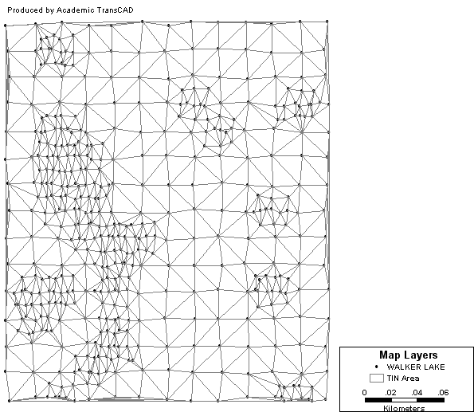
Exploration of first order effects:
Delaunay Triangulation

Slide 12
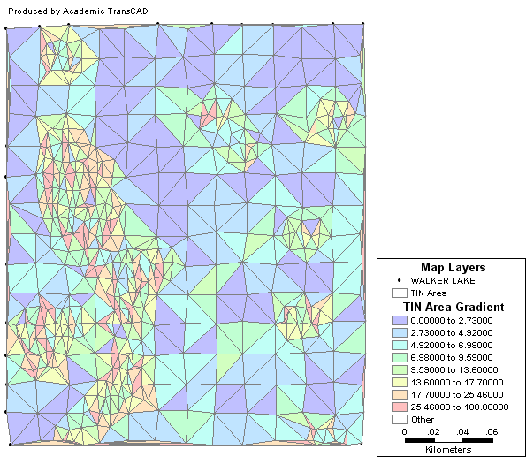
Exploration of first order effects:
Gradient map

Slide 13
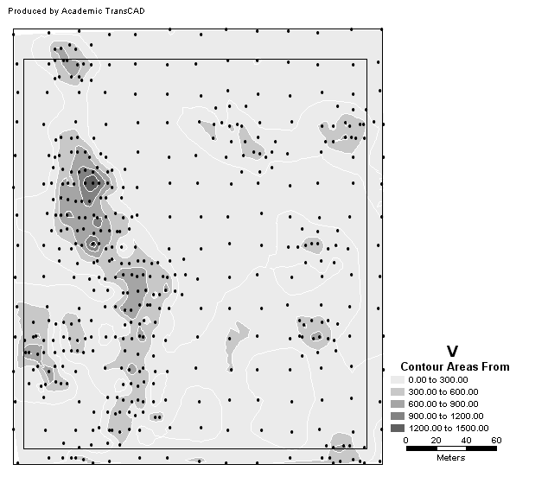
Exploration of first order effects:
Contour areas

Slide 14
Second order effects:
Smaller scale variation
Point patterns
  Nearest-neighbor distance analysis
Spatially continuous data
  Covariation of neighboring observations

Slide 15
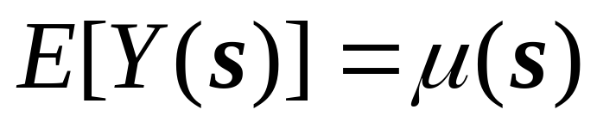
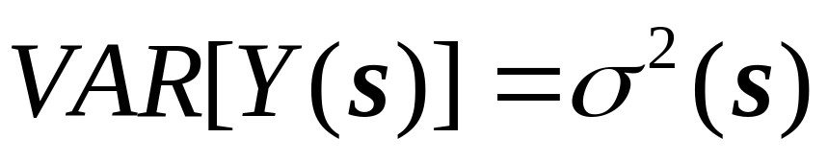
Definitions
Mean and variance of a spatial random variable

Slide 16








Mean and variance of a spatial random variable

Slide 17
Covariance of the process
Covariance of the process between s_{i} and s_{j}
C(s_{i},s_{i})=σ²(s_{i})

Slide 18
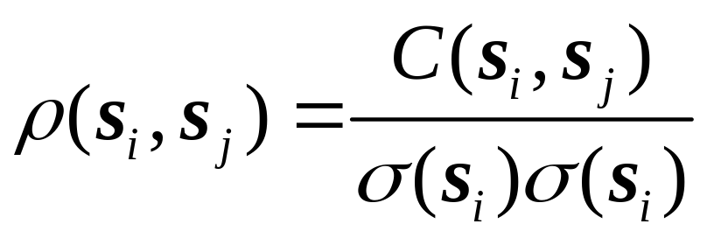
Correlation of the process
Correlation of the process between s_{i} and s_{j}

Slide 19


Mean and variance in a stationary process

Slide 20
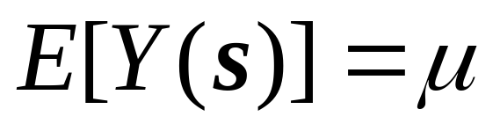
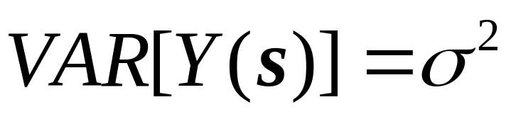
Definitions
Mean and variance of a spatial random variable (stationary process)

Slide 21
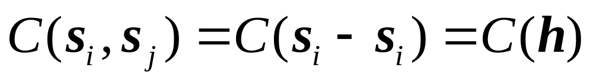
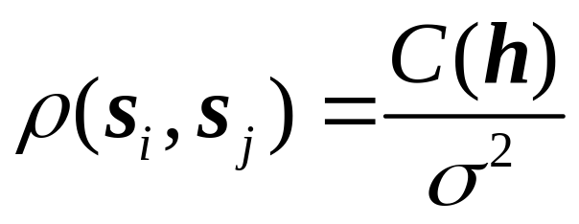
Covariance of a stationary process
Covariance of the process between s_{i} and s_{j} depends on distance and direction only
Correlation

Slide 22
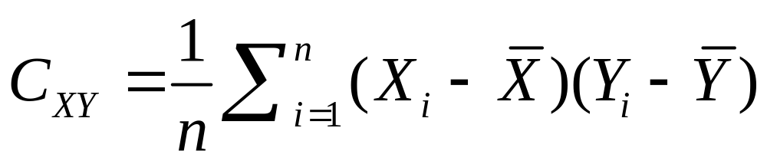
Covariance (two variables)
Covariance

Slide 23


Covariance (two variables)
Covariance

Slide 24
Covariance (two variables)
Covariance

Slide 25
Covariance (two variables)
Covariance

Slide 26
Covariance at various spatial lags
y₁=8 y₂=9 y₃=8 y₄=7 y₅=6 y₆=7 y₇=8 y₈=9
y=7.75
1
h=1
6
2,7
5
3
4

Slide 27
Covariance at various spatial lags
y₁=8 y₂=9 y₃=8 y₄=7 y₅=6 y₆=7 y₇=8 y₈=9
y=7.75
(y1,y2)
h=1
(y6,y7)
(y2,y3)
(y7,y8)
(y5,y6)
(y3,y4)
(y4,y5)

Slide 28
Covariance at various spatial lags
y₁=8 y₂=9 y₃=8 y₄=7 y₅=6 y₆=7 y₇=8 y₈=9
y=7.75
(y6,y9)
h=2
(y5,y7)
(y1,y3)
(y2,y4)
(y4,y6)
(y3,y5)

Slide 29
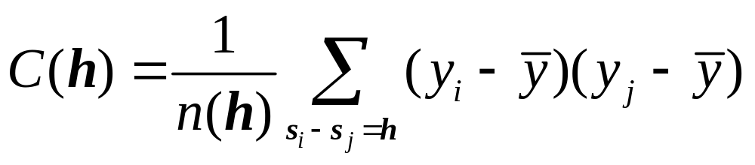
Covariogram
A plot of the covariance of the process at various spatial lags

Slide 30
Covariogram
C(0)=σ²
h

Slide 31
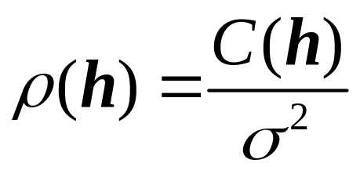
Correlogram
ρ(0)=1
h

Slide 32
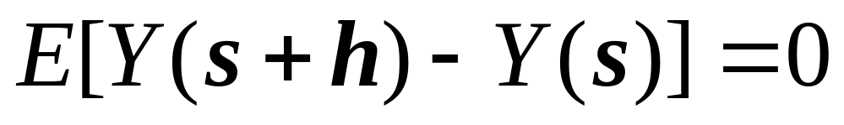
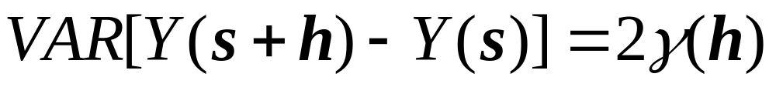
Variogram
Intrinsic stationarity (weaker assumption)

Slide 33
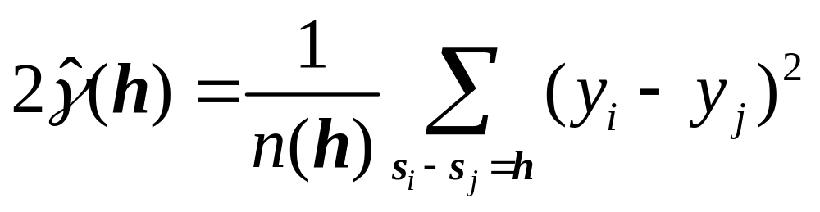
Variogram
Intrinsic stationarity

Slide 34
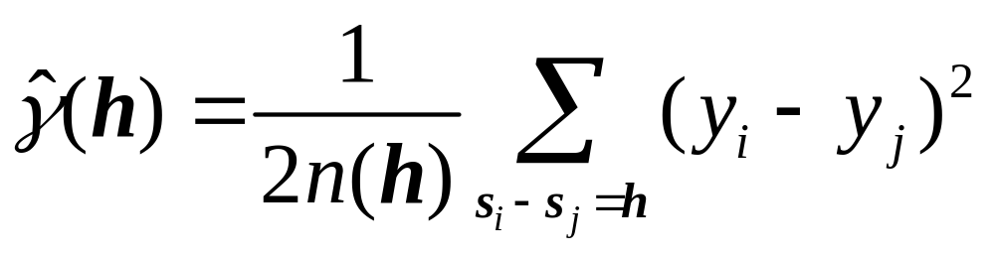

Variogram
σ²
Sill
Range
h

Slide 35
Covariogram, correlogram, variogram
Covariogram
Correlogram
C(0)=σ²
ρ(0)=1
h
h
Variogram
σ²
h

Slide 36
How to read the variogram

Slide 37
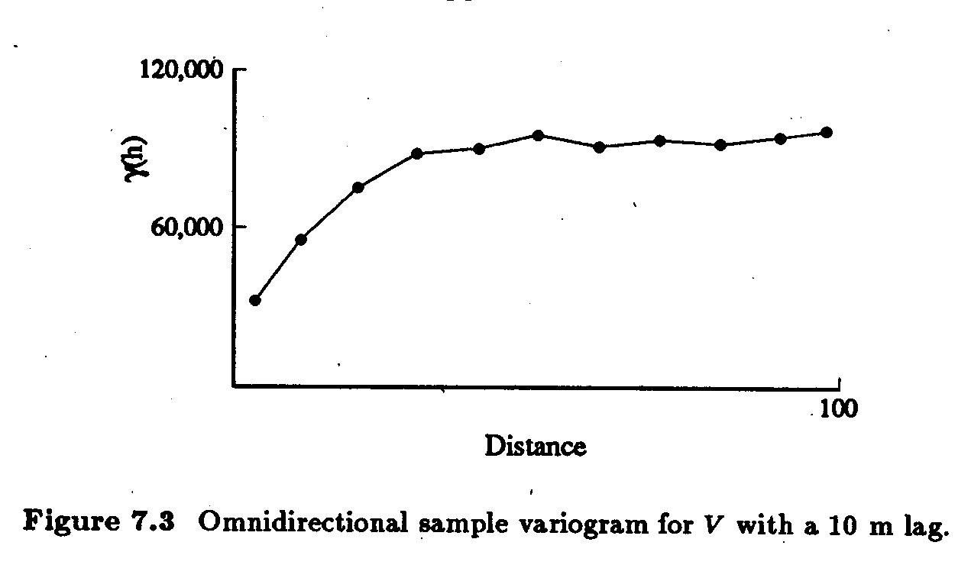
How to read the variogram
Example of variogram

Slide 38
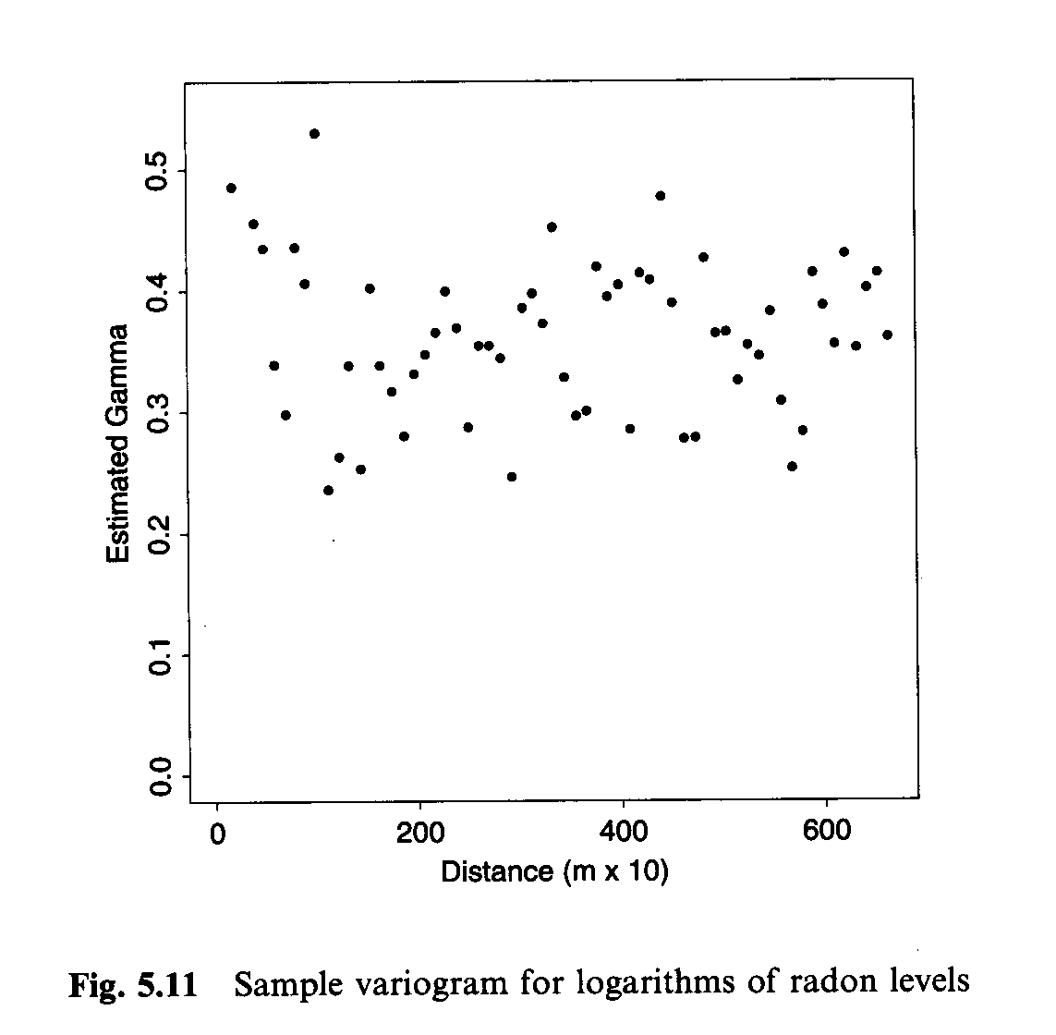
How to read the variogram

Slide 39
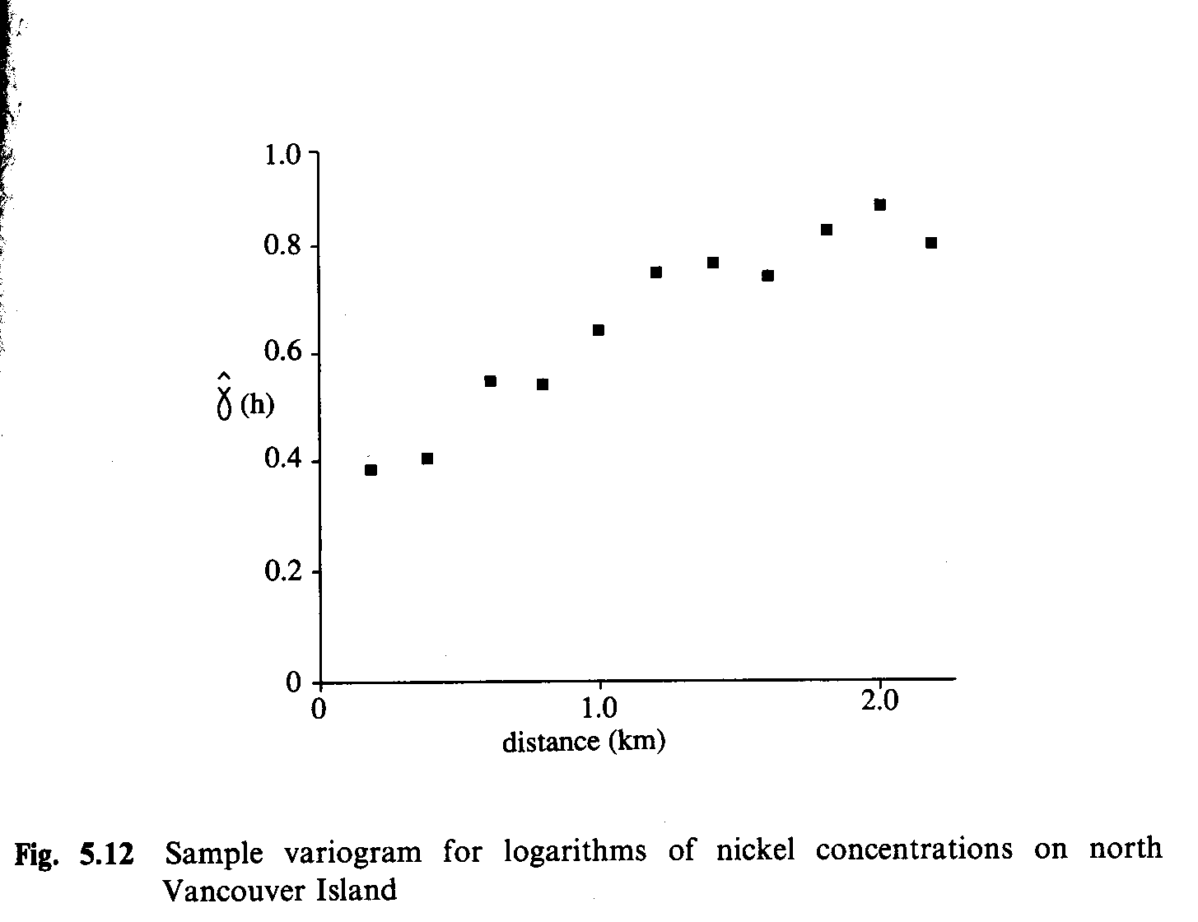
How to read the variogram

Slide 40
Some important issues
Selection of spatial lags h

Slide 41


Some important issues
Selection of spatial lags h

Slide 42
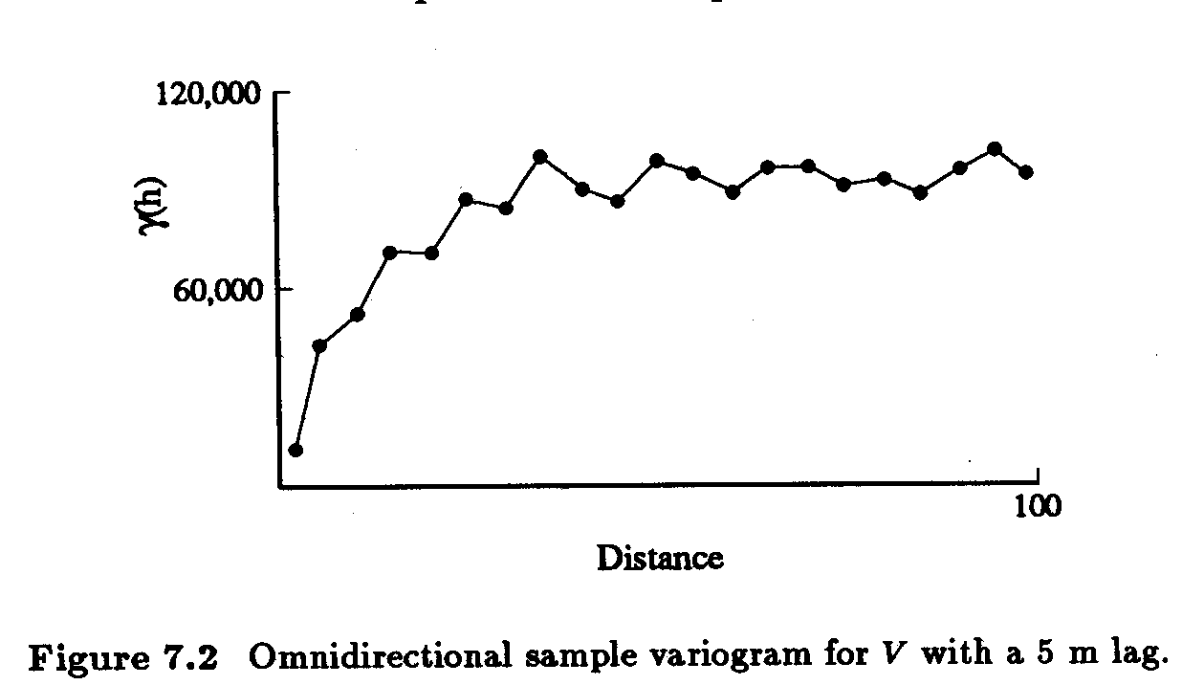
Some important issues
Selection of spatial lags h
  Number of point pairs
  Few points, low reliability

Slide 43
Some important issues
Selection of spatial lags h
  Number of point pairs
  Few points, low reliability
…
(4856)
(5140)
(3044)
(178)

Slide 44
Some important issues
Directional variograms

Slide 45
Directional variograms

Slide 46

Some important issues
Selection of spatial lags h

Slide 47
Summary
The covariogram, correlogram and variogram and exploratory tools to study second order properties of spatially continuous data
The variogram is more resistant to departures from the assumptions
These tools are also the basis of more sophisticated interpolation methods (next level)

Slide 48
Next…
Area Data

